Slide 1
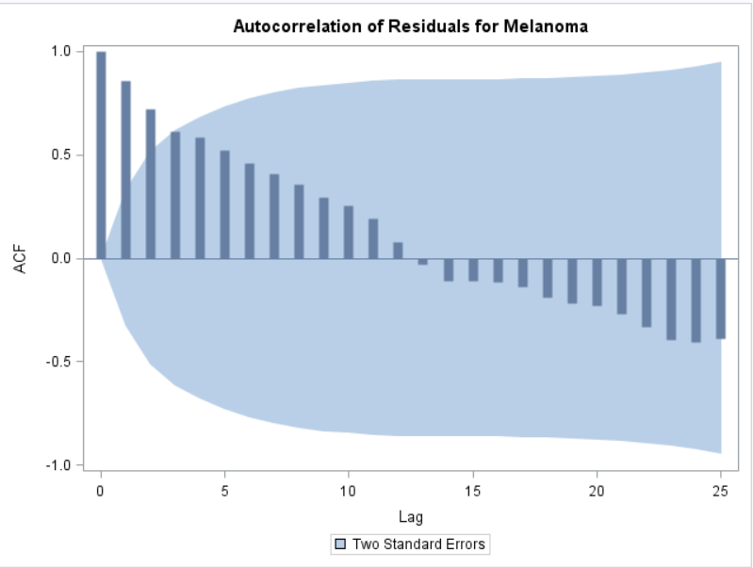
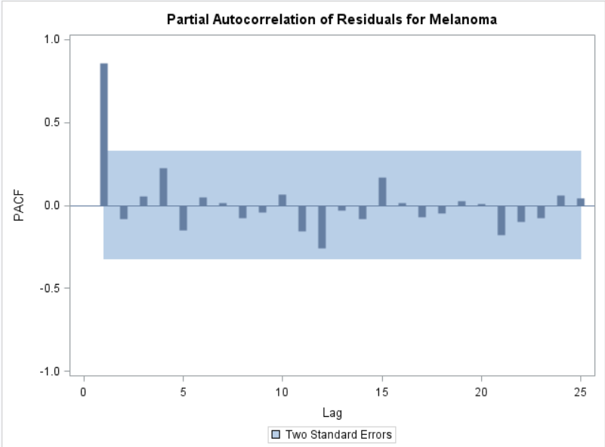
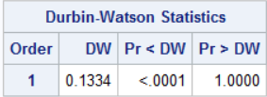
Discussion A
These are the ACF and the PACF from the first block of code which uses only sunspots to model melanoma. The ACF shows strong evidence for serially correlated data. As you get further from lag 0 the less and less correlated the data points are.
The PACF shows evidence that this follows the AR(1) model since lag 1 is highly correlated to lag 0 but nothing beyond that is statistically significant.
The DW statistic is also significant and its low value is further evidence of positive autocorrelation.

Slide 2
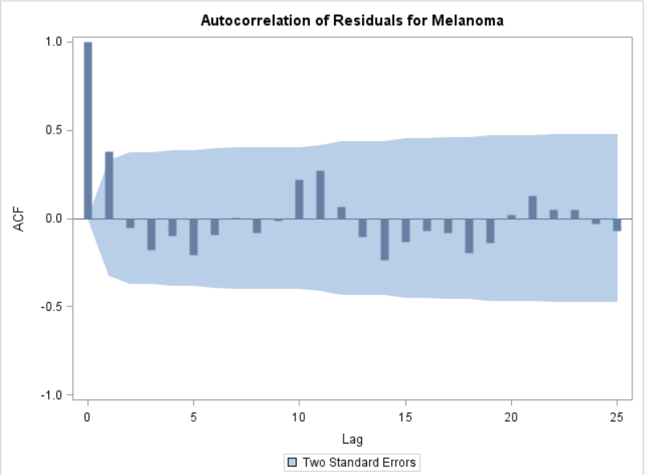
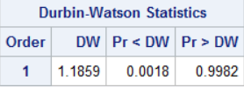
Discussion A
Adding year to the model has helped to reduce autocorrelation but hasn’t eliminated it. The trend is not as clear in the ACF plot (though now there seems to be some kind of cyclical trend) and the DW statistic is higher (ie closer to 2) which also indicates that serial correlation is less severe.
The PACF (not shown) is also less severe but still suggests AR(1).

Slide 3
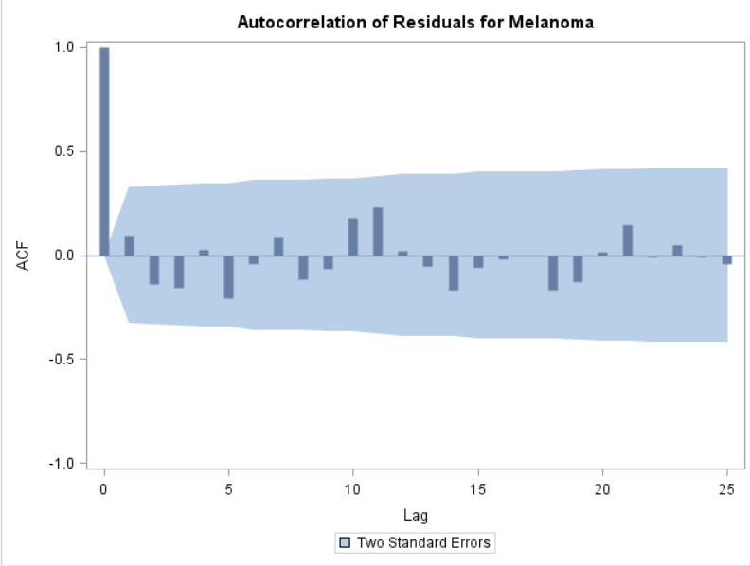
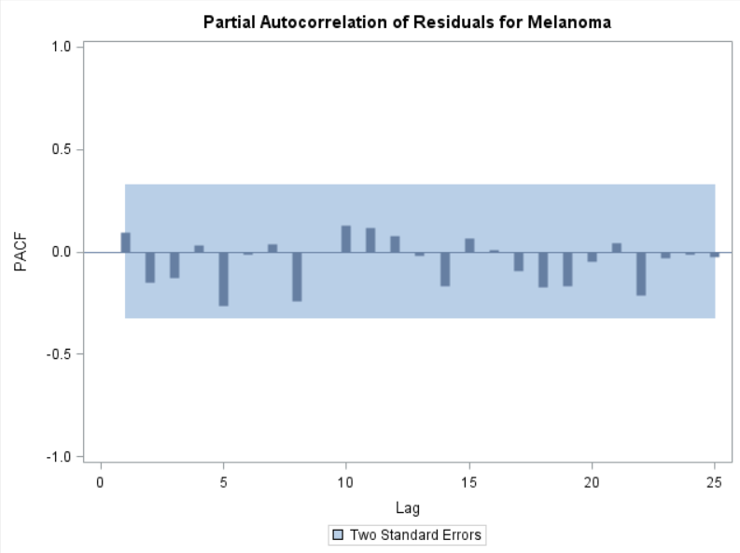
Discussion B
Setting the model to account for AR(1) appears to have eliminated effects due to autocorrelation in the ACF and PACF.

Slide 4
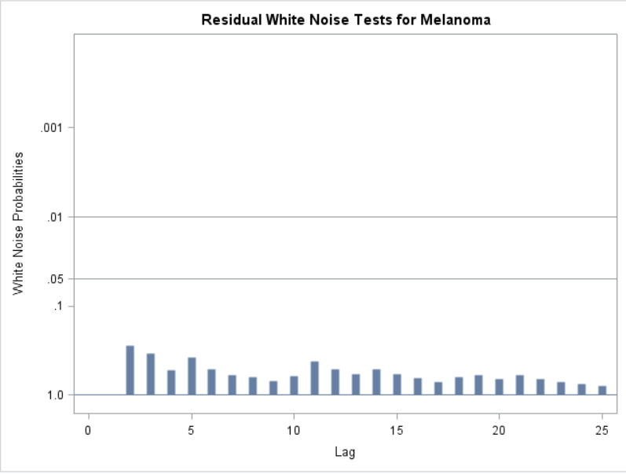
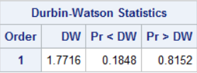
Discussion B
Additional evidence that autocorrelation is no longer influencing our model is provided by the white noise test and the DW statistic. The white noise test shows that any autocorrelation that appears is due to random chance (ie white noise).
The DW statistic is not significant which provides no evidence for autocorrelation.

Slide 5
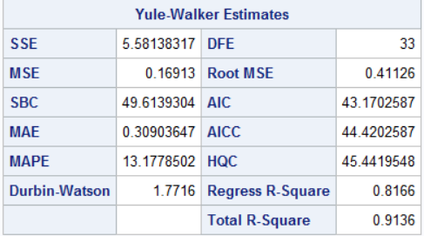
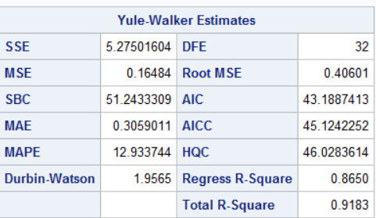
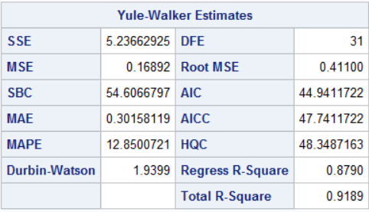
Discussion B
AR1
AR2
AR3
The AIC, AICC, and SBC are all lowest for the AR(1) model which indicates it best fits the data and the AR(1) coefficient should be used.

Slide 6
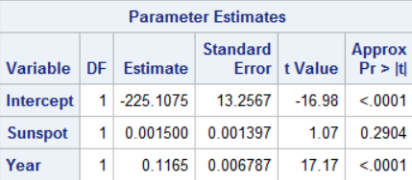

Discussion C
The number of sunspots is not a significant parameter even with the AR(1) model. Perhaps there are other factors that could be added to the model which would be more significant and improve the fit. However we already have an R^2 of 0.8981 with this model so there may not be much room for improvement.

